Slide 1
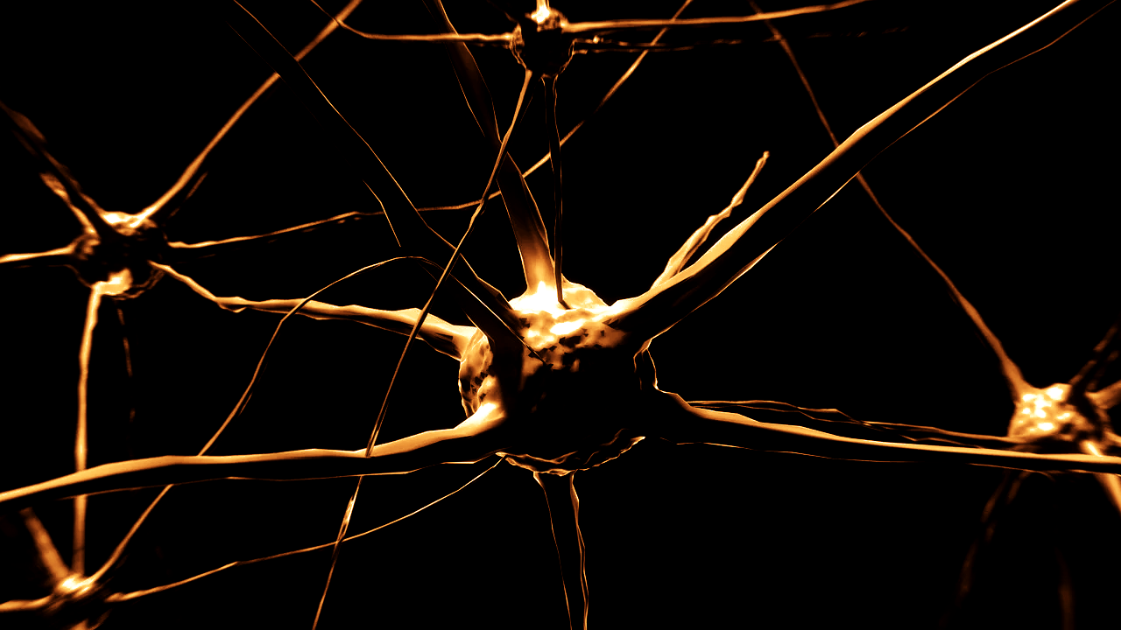
What is a Neural Network?

Slide 2
What is an artificial neural network?
Machine learning framework
Mimics the learning pattern of the brain’s neural networks

Slide 3
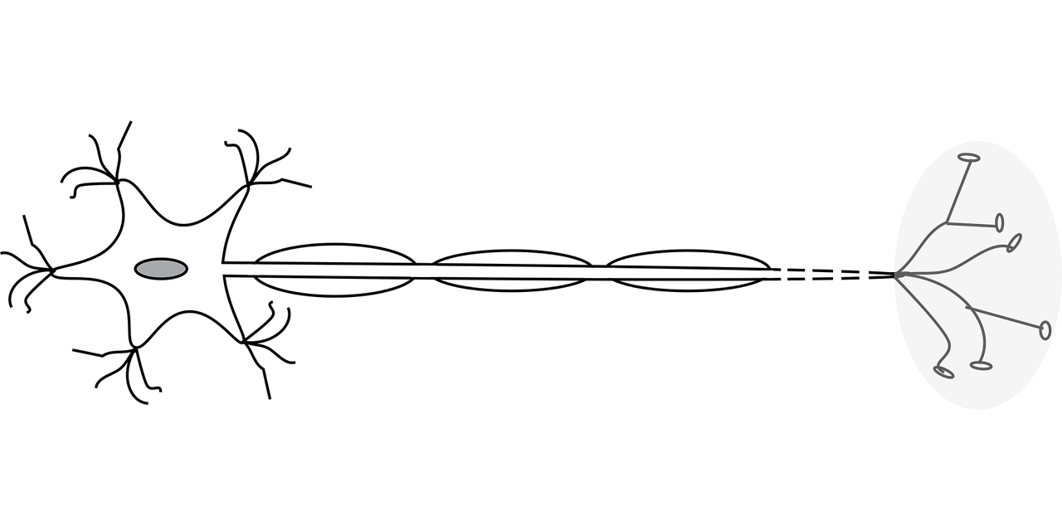
What is a natural neural network?

Slide 4
What is a natural neural network?
Interconnected neurons that receive inputs
Produce output signal through an axon to another neuron

Slide 5
How do you build a neural network?
Input layer takes in feature inputs
Add hidden layers
Output layer makes outputs

Slide 6
Layers
Input hidden hidden output

Slide 7
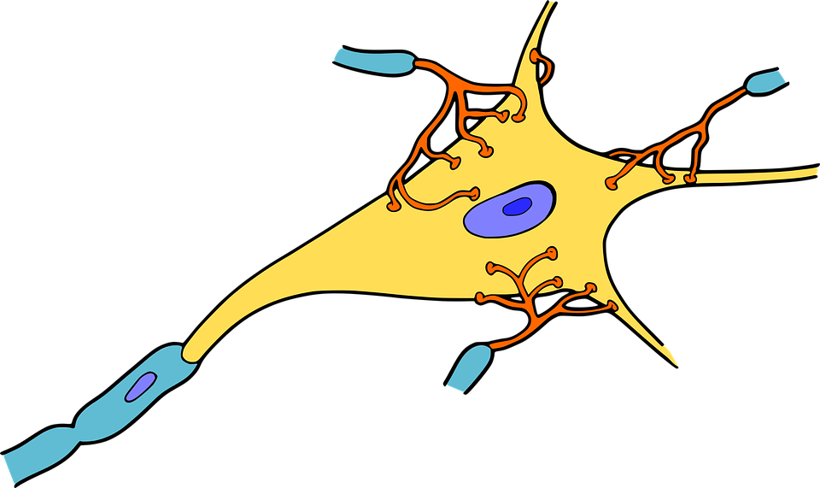
What is a neuron?
Calculates weighted sum of inputs from predecessor neuron
Applies an activation function to produce its output

Slide 8
How do you build the layers?
Start with 1 perceptron
Add layers of perceptrons together

Slide 9
What is a perceptron?
Receives inputs
Multiplies inputs by a random weight
Adds a bias to account for inputs of 0
Passes inputs to an activation function to produce an output

Slide 10
What do you do with the output?
Compare the output to a known label
Adjust weight accordingly
Repeat until there are no more allowed iterations or the error rate is acceptable

Slide 11
How do you build a perceptron?
At least 1 input
Bias
Activation function
1 output

Slide 12
Types of neural networks
Feedforward (NN)
  Connections only in 1 direction

Slide 13
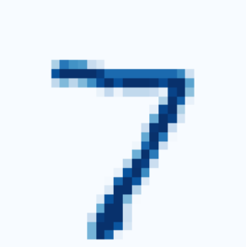
Types of neural networks
Convolutional (CNN)
  Takes adjacency into account
  Grid topology data (images)

Slide 14
Types of neural networks
Recurrent (RNN)
  Feeds outputs back into its own inputs
  Sequential data (language)

Slide 15
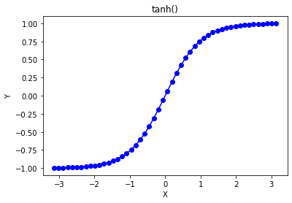
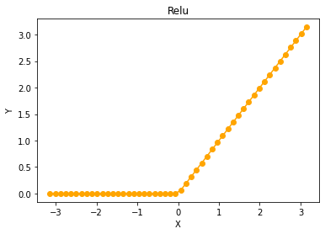
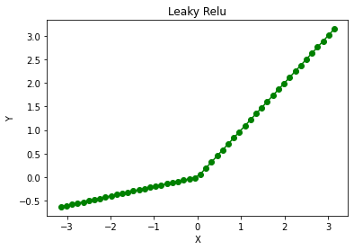
Activation Function
Nonlinear function
  Allows large networks of neurons to represent arbitrary functions

Slide 16
What is a Neural Network? ✓

